Slide 1
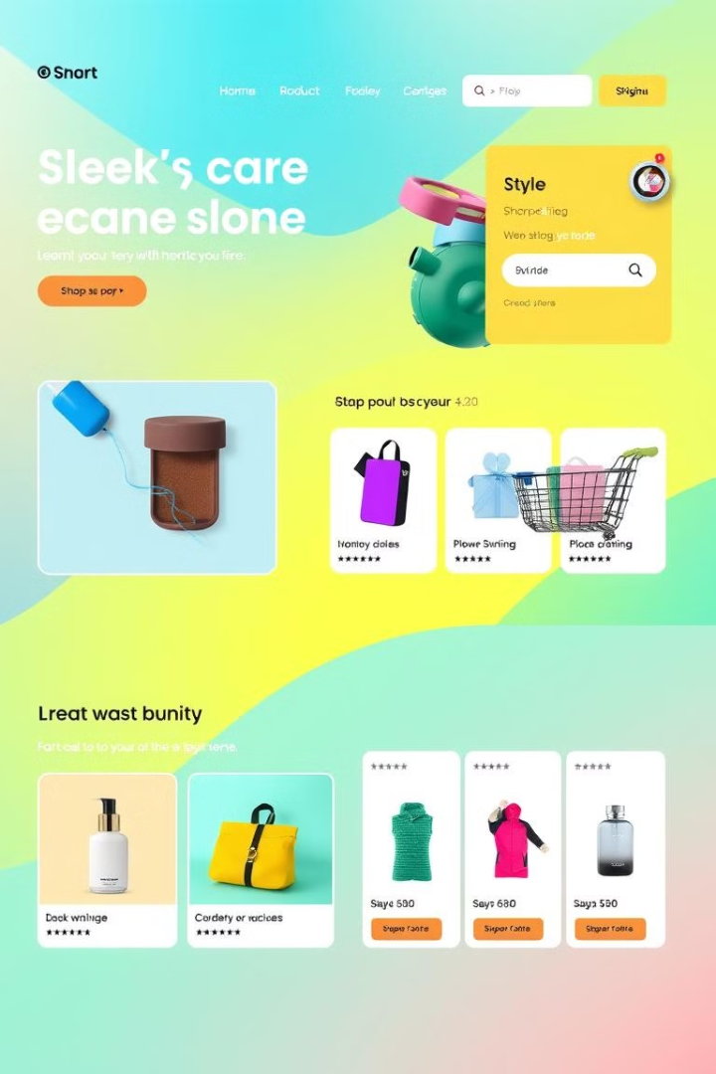

Building an E-commerce Website with PHP, MySQL, and React
This presentation will explore the essential components and technologies involved in developing a comprehensive e-commerce website from the ground up. We'll delve into both the backend and frontend aspects, highlighting the key elements of each.
by Yaar Badashah

Slide 2
Introduction to E-Commerce
Growth Potential
Customer Convenience
Data Insights
Scalability and Automation
E-commerce offers significant growth potential for businesses, allowing them to reach a wider audience and expand their reach beyond traditional brick-and-mortar stores.
E-commerce platforms provide valuable data insights into customer behavior and preferences, allowing for data-driven business decisions.
Customers can shop from anywhere, anytime, with a wide selection of products at their fingertips, making it incredibly convenient.
E-commerce websites can scale effortlessly to accommodate growing customer demand and automate many business processes.

Slide 3

Backend Architecture
PHP
MySQL
PHP serves as the programming language for the server-side logic, processing user requests, managing data, and generating dynamic content.
MySQL acts as the database management system, securely storing and managing product information, user data, orders, and other essential website data.
API Endpoints
API endpoints serve as communication channels between the backend and the frontend, enabling data exchange and functionality like adding products to the cart.

Slide 4
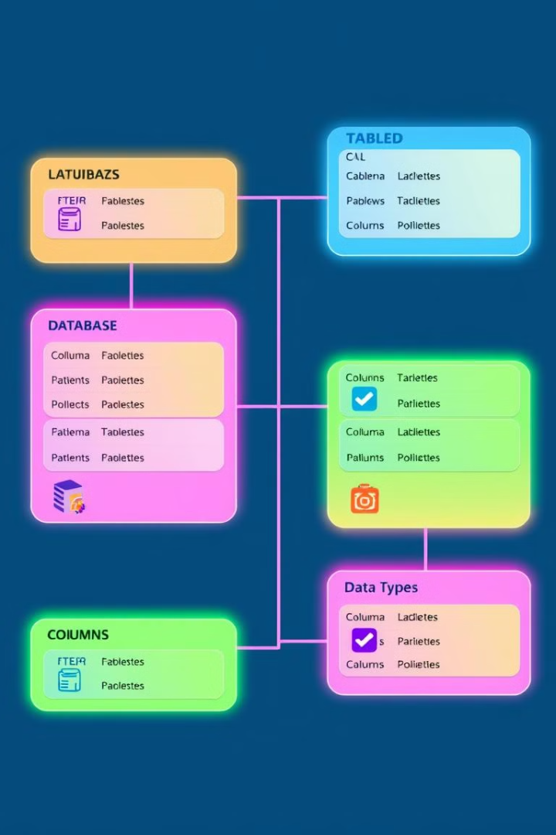



MySQL Database Design
Data Integrity
A well-designed database ensures data integrity, consistency, and accuracy, crucial for the smooth operation of the website.
Efficient Queries
Proper indexing and optimization of the database schema enable efficient queries and fast data retrieval for a seamless user experience.
Data Security
Security measures like encryption and access control are essential to safeguard sensitive customer information and prevent unauthorized access.

Slide 5




PHP Server-Side Development
User Authentication
PHP handles user registration, login, and session management, ensuring secure access to personalized features and data.
Order Processing
PHP processes customer orders, calculates shipping costs, handles payment gateways, and sends order confirmations and notifications.
Dynamic Content
PHP generates dynamic content for product pages, category listings, search results, and other website sections based on user interactions and data.

Slide 6
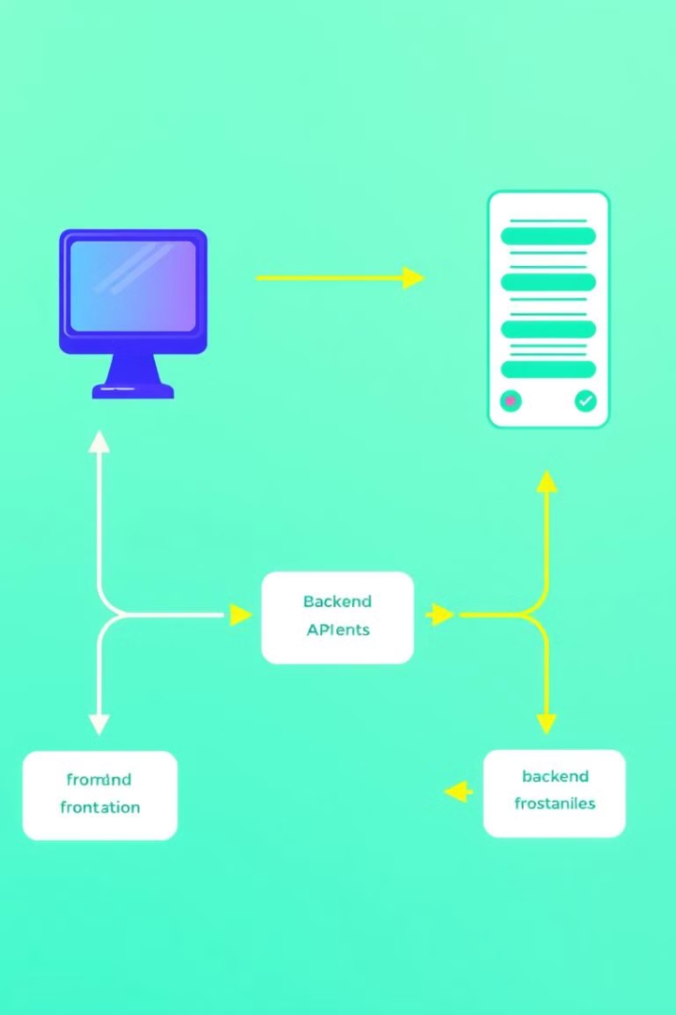
API Endpoints and Integration
1
RESTful API
2
Data Exchange
RESTful API design principles are employed to create structured and standardized endpoints for efficient communication between the frontend and backend.
APIs facilitate the exchange of data such as product information, user details, order details, and shopping cart contents.
3
Third-Party Integrations
Integration with third-party services like payment gateways, shipping providers, and analytics tools enhances website functionality and user experience.

Slide 7

Frontend with React
Component-Based Architecture
1
React's component-based architecture promotes modularity, reusability, and code maintainability, making development efficient and scalable.
2
Virtual DOM
React's virtual DOM optimizes performance by efficiently updating only the necessary parts of the user interface when data changes.
JSX Syntax
3
JSX syntax allows you to write HTML-like markup within JavaScript code, simplifying the process of building user interfaces.

Slide 8



State Management and Component Lifecycle
State Management
State management techniques like Redux or Context API enable efficient and organized handling of data changes across multiple components.
1
Component Lifecycle
2
React components go through a lifecycle with distinct phases such as mounting, updating, and unmounting, providing hooks for managing side effects and data manipulation.
Event Handling
3
React provides a robust event handling system for responding to user interactions, such as button clicks, form submissions, and mouse movements.

Slide 9
Responsive Design and Accessibility
Cross-Browser Compatibility
1
Ensure the website functions correctly across different browsers and devices, providing a consistent and enjoyable user experience.
Accessibility Standards
2
Adhere to accessibility standards (WCAG) to make the website usable and accessible for users with disabilities.
Responsive Design
3
Employ responsive design techniques to adjust the layout and content of the website to fit various screen sizes and orientations.

Slide 10

Deployment and Hosting
1
Cloud Hosting
Choose a reliable cloud hosting provider for scalability, performance, and security, ensuring a smooth and efficient website operation.
2
Deployment Process
Establish a robust deployment process to efficiently push code updates and maintain website stability.
3
Monitoring and Maintenance
Implement monitoring tools to track website performance, identify potential issues, and perform regular maintenance to ensure optimal functionality.

